Slide 1

Rockbuster Stealth
Business Intelligence Report
Created by: Dylan Golcher

Slide 2
Overview & objectives
Project Overview:
Once a profitable business model, the brick-and-mortar movie rental industry has undergone a paradigm shift in recent years with the growing popularity of streaming services such as Netflix, Amazon, and Hulu. To maintain profitability and appeal to more customers, Rockbuster Stealth has decided to launch its own streaming/digital rental service.
Key Objectives:
Understand which tables in our database are most/least profitable
Understand which genres are the most/least profitable
Understand where out customers reside
Understand how sales figures differ by region
Understand who are highest value customer are

Slide 3






Rockbuster stealth stats at a glance
Let’s look at some key Rockbuster statistics for our current business model :
599 Customers
2.99 Average rental rate
1000 Films
5 Day average rental duration
Most movies rated PG-13
Customers in 108 countries worldwide

Slide 4
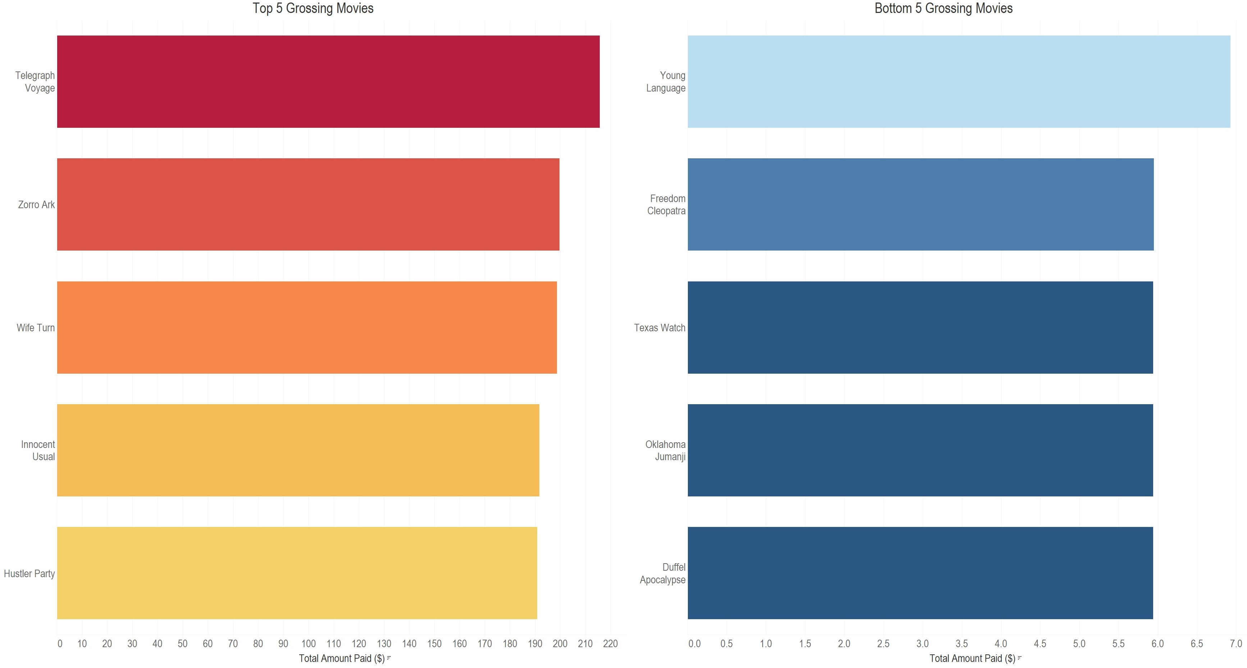
Film portfolio: top 5 & bottom 5
Let’s compare our top 5 highest grossing movies to our bottom 5.

Slide 5
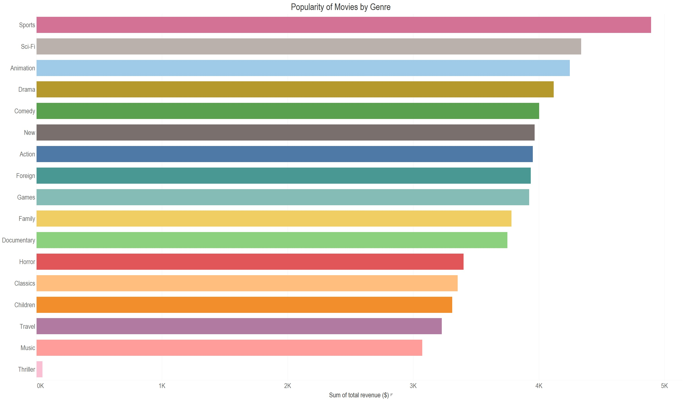
Film portfolio: Genre comparison
How do our genres compare in revenue?

Slide 6
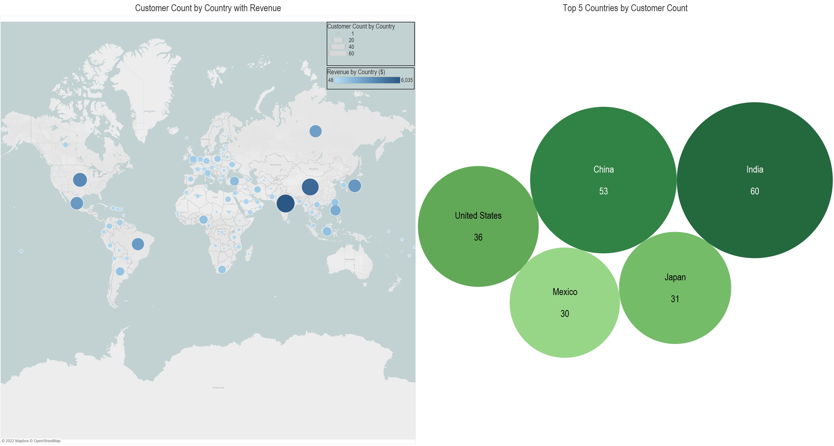
Customer distribution
Rockbuster has a customer base in 108 countries, with the highest concentrations in India, China, the United States, Japan, and Mexico.

Slide 7
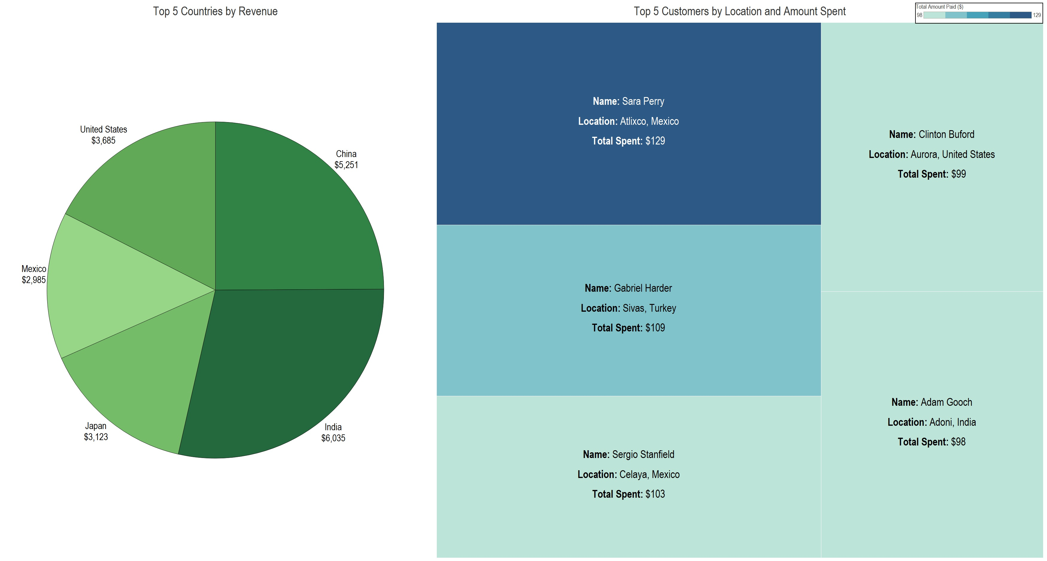
Revenues: countries & customers
The top 5 countries for revenue mirror the top 5 countries for customer presence. Over half (54%) of all sales come from India and China.
4 of our top 5 most valuable customers are located within the top countries for revenue.

Slide 8
Recommendations
Selection
Assure popular titles are well stocked in physical locations
Prioritize movies with MPAA ratings of PG-13 or less to appeal to larger audiences
Top genres, including sports, sci-fi, animation, drama, and comedies should represent a large proportion of our inventory
Customer Base
Understand the regional differences in the preferences of our customers by frequently analyzing viewing trends; a one size fits all approach will not adequately represent our customer base
Incentivize spending at Rockbuster with a rewards program to entice new customers and maintain loyalty with existing customers. Possible rewards could include:
  Discounts on rentals
  Early access to new releases
  Free rental vouchers for birthdays or reaching Rockbuster anniversary milestones (i.e., 1 year, 5 year, etc.)

Slide 9
Recommendations
Revenue
Closely monitor regions with high ROI, such as India and China, which account for over half of company sales; maintain a strong advertising presence and a focus on customer retention efforts
Use research methods, such as surveys, social media monitoring, and online tracking to explore other markets for possible expansion or to bolster our current presence
Assure entrance into new markets is both economically feasible and the market has a measurable interest in the film industry based on the aforementioned research methods.
Analyze the telecommunications standards in new markets to assure bandwidth requirements for streaming services are sufficient

Slide 10
Questions and follow up
For any questions regarding this presentation, data sourcing, or the data analysis, please contact me at: dgolcher86@gmail.com
To view the Tableau visualizations used in this presentation, please use the following link: Rockbuster Stealth Business Report
Thank you!

